Slide 1
I can do it list
Presented by Olga Maunsell

Slide 2
MVP
Create an Android app which will allow the user to maintain a task list.
The user should be able to enter tasks and display them in a list.
The list should only show the bare details of each task.
Selecting a task from the list should bring up another screen which shows full details of the task. Users should also be able to mark tasks as completed.

Slide 3
User Story
Typical user wants a simple to use app
Not interested in entering due dates for tasks as gets enough notifications – can use phone calendar if needs a date prompt !
Likes visuals and wants to be able to mark tasks as a priority and see a list of priority only tasks

Slide 4
Olga’s Extensions
Menu options to allow:
- Different filters of task list
- Another option to add a New Task
Priority checkbox on New Task and Edit Task

Slide 5
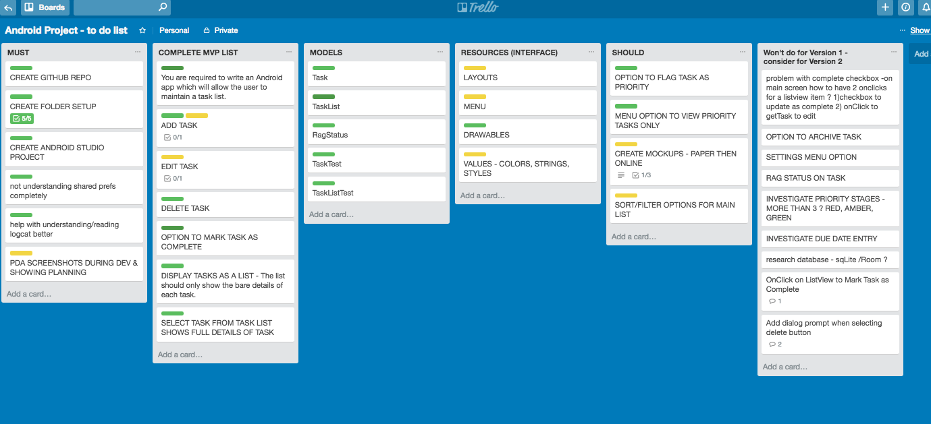
Planning – Trello Board

Slide 6
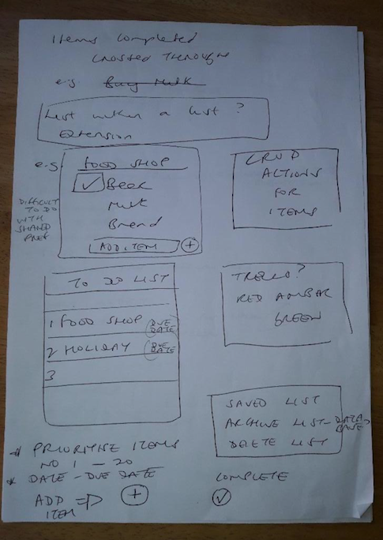
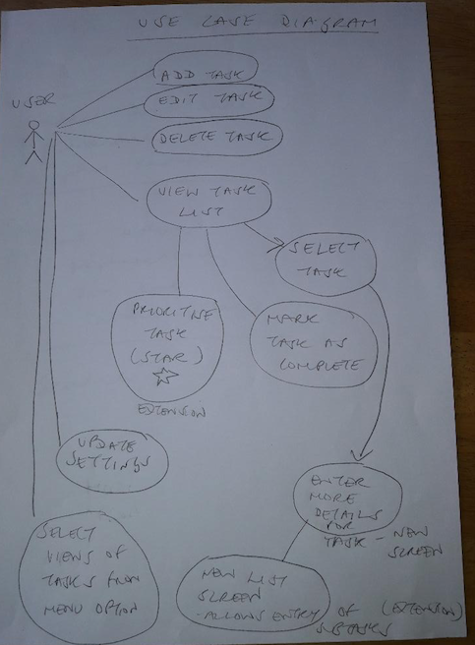
Initial Brain Dump + Use Case Diagram

Slide 7
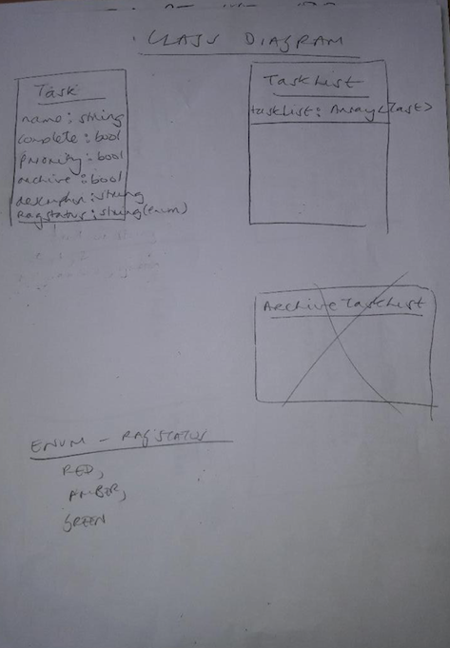
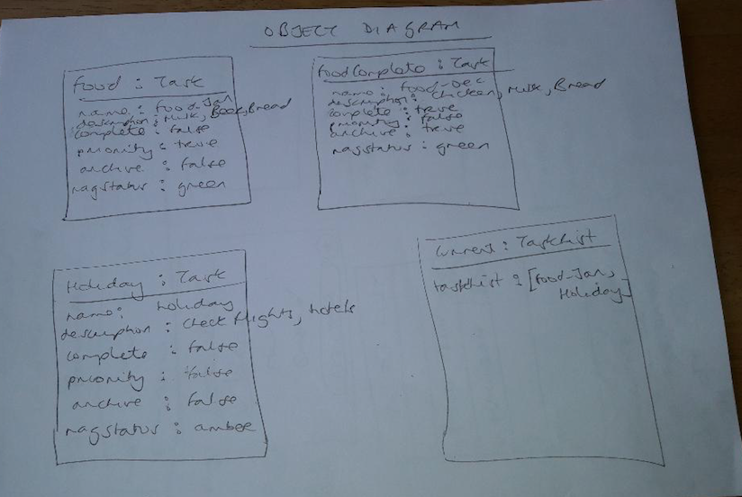
Class Diagram & Object Diagram

Slide 8
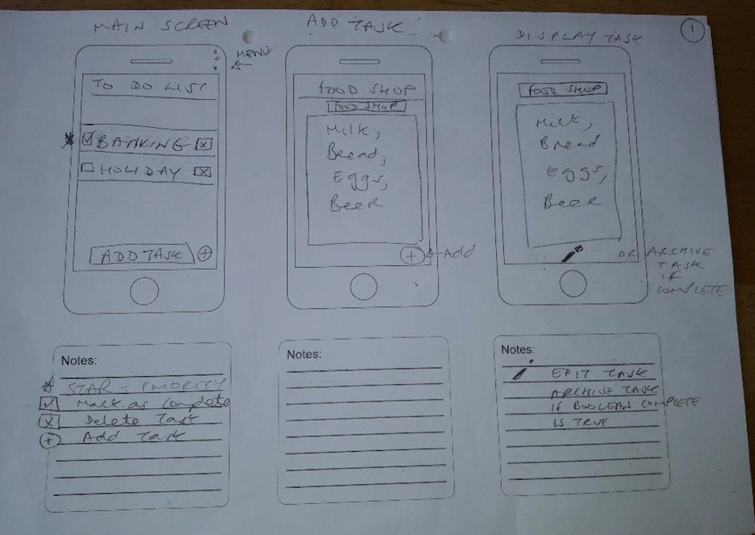
Wireframes

Slide 9
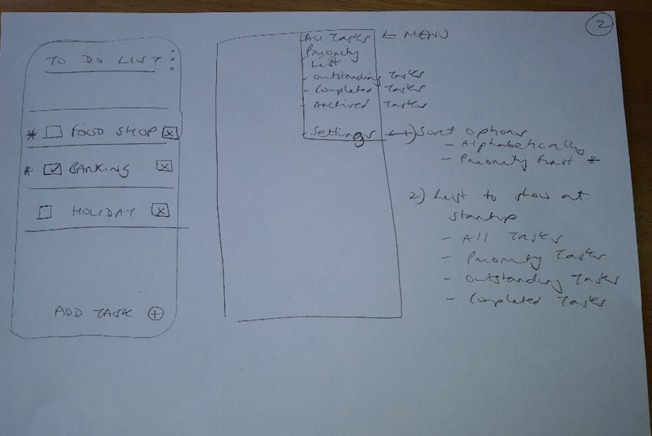
Wireframes

Slide 10
Future Functionality – Version 2 !!
Allow to mark task as complete on Task List screen
Rag Status – RED, AMBER GREEN to show task status progress
Sort options (Priority + A-Z), A-Z only
Dialog prompt for Delete Task
Improve Styling
Refactor code – shared preferences helper class

Slide 11
Lessons learned
Daily to do list helpful
I think I would prefer to work with a database rather than shared preferences

Slide 12
Now here’s the demo !

